Slide 1

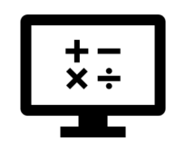
Big Picture
Where do I find MATLAB? Here!
Do I have to have MATLAB installed on my computer right now? No, you can use MATLAB Online!

Slide 2

Table of Contents
Recap of Week 5: Functions and Graphing
Big Picture: Computational Thinking
What is computational thinking?
Why is computational thinking important?
How do we become computational thinkers?
What we've covered this week: Big Picture
Extra resources
References
MATLAB Live Script

Slide 3
Recap of Week 5: Functions and Graphing
Last week, we learnt about:
Interactive plotting
Programmatic plotting
Creating and calling functions
Function workspaces
Creating a function file
Debugging and error handling
In this we have three parts to cover, beginning the Bigger Picture: Computational Thinking, covering the following sub-topics:
What is computational thinking?
Why is computational thinking important?
How do we become computational thinkers?

Slide 4
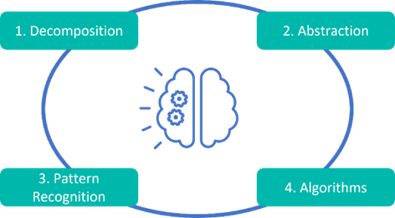
Big Picture: Computational Thinking
What is computational thinking?
Computational thinking is the ability to apply traditional programming techniques to solve mathematical, scientific and engineering problems, leveraging a programming language or application software. The thinker formulates and captures their ideas in a reusable and maintainable form for a computer to produce the solutions. This process can be broken down into 4 main steps:

Slide 5
Big Picture: Computational Thinking
Decomposition - Breaking down a large (often complex) problem into smaller, more digestible sub-problems that can be solved
Pattern recognition - Identifying similarities among problems and the methods they have been solved with in the past
Abstraction - Determine what information is relevant to the problem and focusing on that information only to solve the problem at hand
Algorithms - Designing simple and scalable methods for solving sub-problems in the series, combined to solve a larger (often more complex) problem
These steps are not very different from how an engineer would engage with other real-world problems. The core idea is that you have a mathematical approach to problem solving and don't just mindlessly perform calculations.

Slide 6

Why is computational thinking important?
"Computational thinking is a fundamental skill for everyone, not just for computer scientists."
- Dr Jeannette Wing, Director of the Data Science Institute, Columbia University
As Dr Wing has pointed out, our ever-evolving world is becoming increasingly dependent computational thinking across many more fields than Computer Science. Cognitive flexibility, digital literacy and computational thinking, among other skills, are all key to the success of our graduates.

Slide 7
How do we become computational thinkers?
The burden of attaining computational thinking, as with other skills for survival, lies on both the educator and the student. Your lecturers will expose you to a plethora of information as you embark on your education journey, your university has equipped you with software tools to match the relevant science and mathematics courses your will encounter, it is up to you to engage with these and try gain as much as you can while you have the opportunity.
In the "What is computational thinking?" subsection, we broke the thinking process down to four main components. Let us use these components to define a path for acquiring this thinking competency:
When facing a complex and intricate problem, break it down into smaller, more digestible sub-problems that you can solve. - Decomposition
Look for patterns among problems and the methods used to solve them. Always asked yourself if someone has solved this problem before. Work smart not hard. - Pattern recognition
Try identifying what information is actually important when solving a problem. Focus on the diamond, not the dirt. - Abstraction
Design simple and scalable methods to solving your sub-problems in series, and combine them to solve the greater, more complex problem. - Algorithms

Slide 8
What we've covered this week in part 1: Big Picture
This week in part 1, we learnt about:
What is computational thinking?
Why is computational thinking important?
How do we become computational thinkers?
In the next part of this week's content, we will be learning about interoperability, covering the following sub-topics:
Interoperability with other languages
MATLAB and Python

Slide 9
Extra resources
Self-Paced Online Courses

Slide 10
References
Article: Integrating Quantitative Programming Into Your Curriculum
Copyright 2022 The MathWorks, Inc. & Opti-Num Solutions (Pty) Ltd.

Slide 11
MATLAB Live Script
Click on the link below for this lecture’s MATLAB live Script
Week_6_Part_1_Bigger_Picture.mlx

